Slide 1
Dirty Hippy Proposal For Solar Energy
By: Andrew Grattendick, Francy, & Ali Humes

Slide 2
We should use personal solar power.
Questions: Who is using solar power? What benefits does it provide? What city and states benefit most? Where are they using it? How much does St. Louis have to gain? Is it cost effective? IF not how can we make it cost effective? How can we show this? Did we answer our questions? Sort of. Some of the questions proved more difficult to address than others.
Benefits: Carbon Offset. Energy generated by solar panels is energy not bought from utility companies. The average consumer will save money.
Notes:
Everyone knows solar power is clean and green energy, which will make our earth become better. From the data we get, we can see that solar power can bring huge carbon offset and save energy and money not bought from utility companies. So are there possibility that we can reach the popularization of solar power? Yes, there are. From the data we got, there is a huge gap between the buildings qualified for solar power and the existing solar panel installations. So there is huge potential market for the solar power. Here we can have a look at the charts drawn from the data we got.

Slide 3
Null Hypothesis
Personal Solar Panels provide no benefit to individuals nor to society.

Slide 4
Data Sources
Project Sunroof provided half a dozen CSV files with information on Carbon Offset, number of installs, potential installs, and roof information, for every postal code, city, and state in the United States.
Project Sunroof also provided an algorithm to calculate projected savings, but such computations were beyond our current abilities.
Landed surface area of the states came from the U.S. Census Bureau and were compiled into a CSV..
State abbreviations came from wikipedia and were compiled into a CSV.

Slide 5
Data Cleanup & Exploration
Our data clean up process.
Dropping unneeded columns. Dropping Na.
For states, we used group by and sum function to get the aggregating information for all the states.
For cities looking at the top 10 and st. louis.
For counties, looking at only the Zip codes within St. Louis City
Compared the counts qualified and existing installation counts for the different states.
Compared the sunlight with the counts qualified between states using line chart
Compared the sunlight of top 10 cities between the existing projects using colorful bubble charts

Slide 6
Insights & Problems
Insights:
With in the cities I was surprised that the top count qualified was not the same as the cities with the most light or most existing projects.
When looking at the Carbon Offset we also decided to look the Land Surface Area of each state. After looking at just Carbon Offset by State we realized that state area and state population were important factors for the effectiveness of personal solar panels. As surface area seemed to be a more pertinent limiting factor than population we made that our focus.
The amount of energy produced is given as a potential amount. We wanted to tap into the Open Weather Maps API to gather more accurate information by figuring out the average cloud cover for given zip codes and estimating a more accurate cost savings. Unfortunately we didn’t have enough time to look into this data. If we’d had two more weeks this would’ve been the next area of focus.
Problems:
The data did not provide information on cost effectiveness...given that the website provides an average starting point for their website’s calculator..

Slide 7
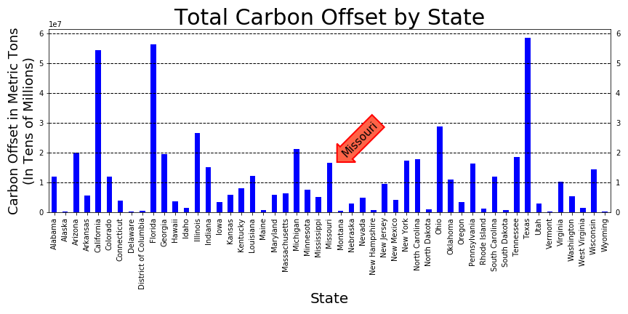

Slide 8
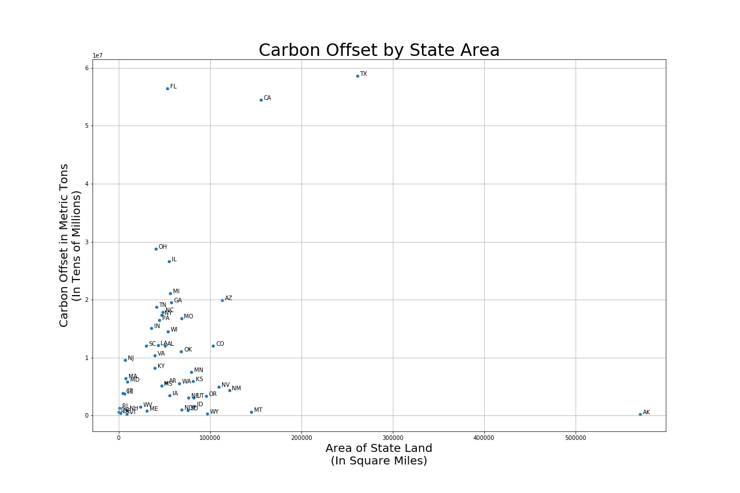

Slide 9
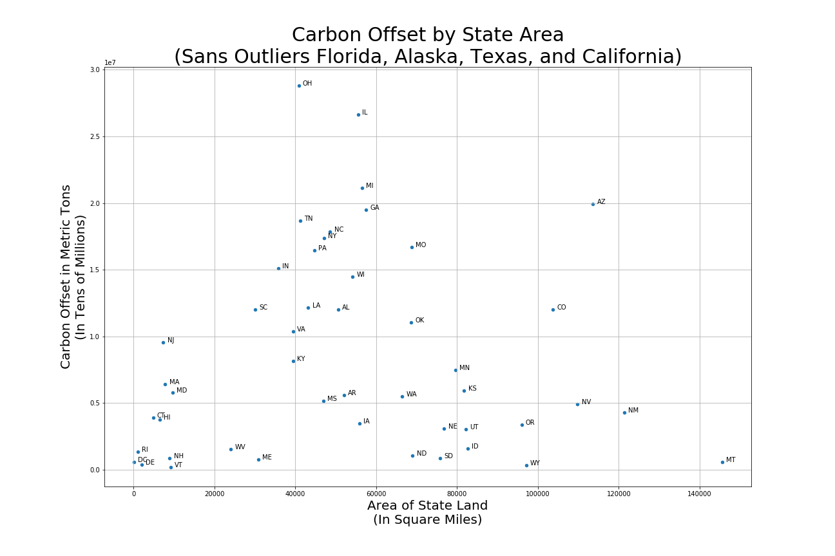

Slide 10
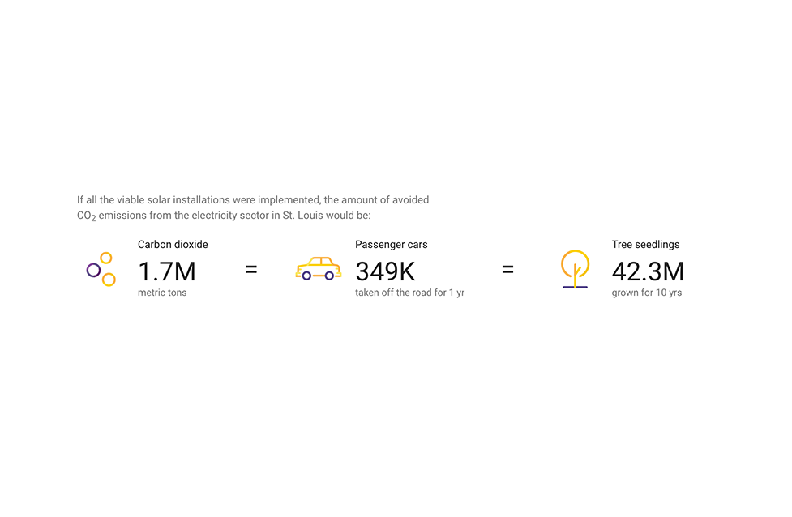
Potential Impact for St. Louis

Slide 11
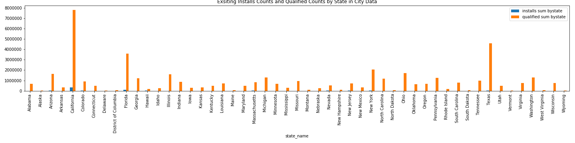
Comparison between existing installs and qualified installs by states

Slide 12
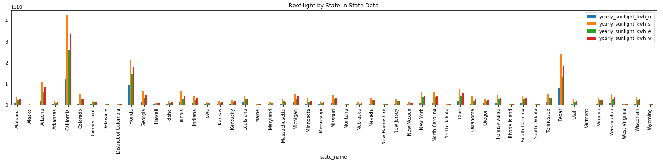
Roof Sunlight by State

Slide 13
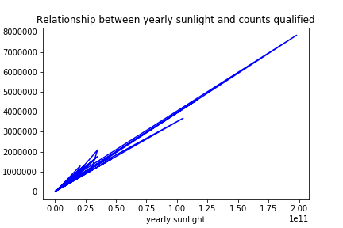
Relationship between yearly sunlight and counts qualified

Slide 14
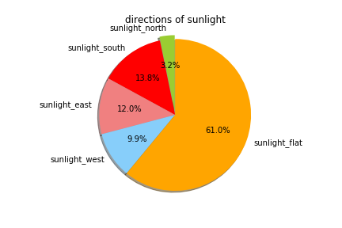
Sunlight for flat roofs takes up the biggest proportion

Slide 15
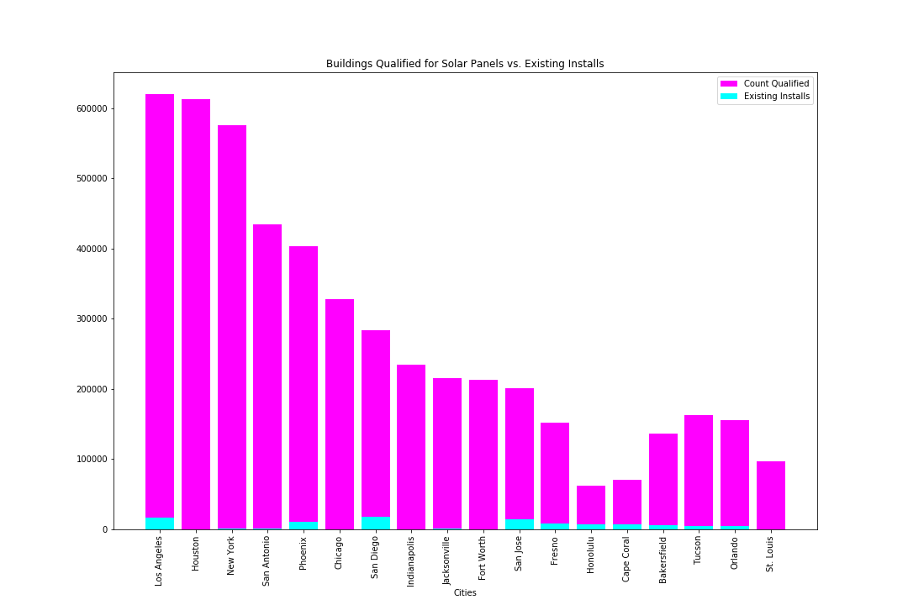

Slide 16
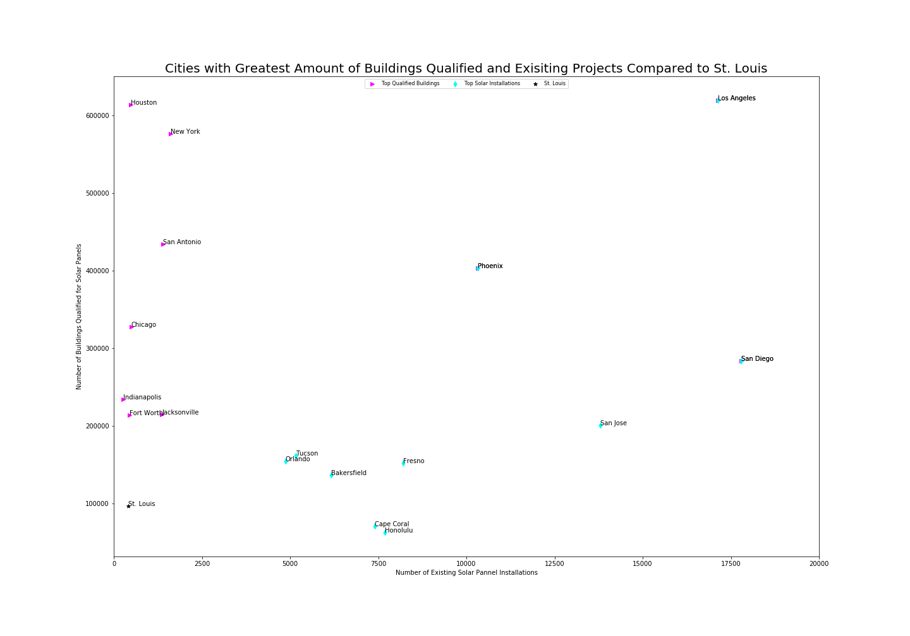

Slide 17
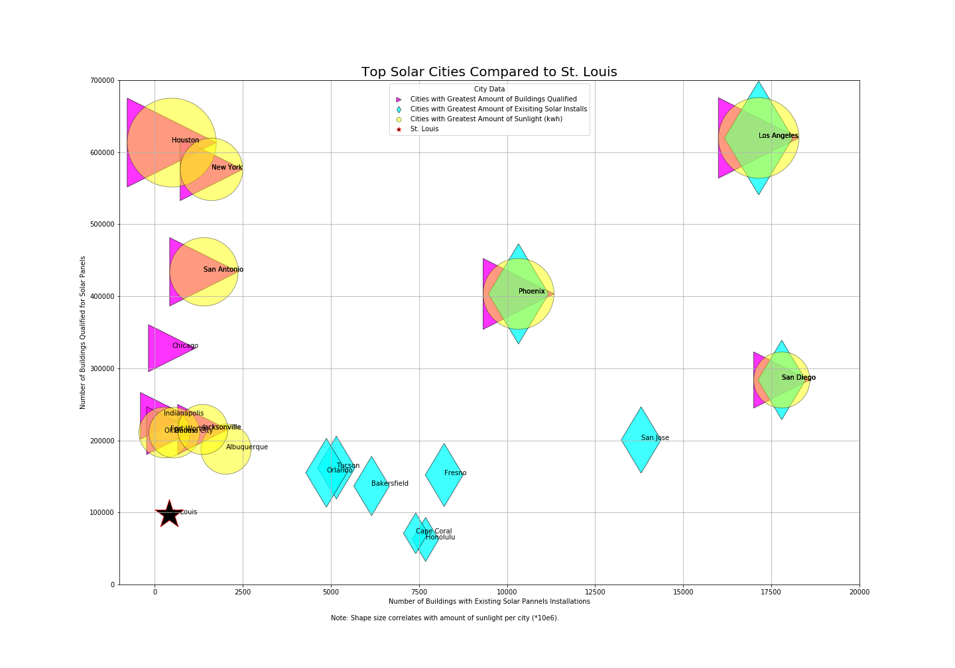

Slide 18
Discussion
There’s a definite carbon offset, and roofs can easily be utilized for this purpose. However there is also a major initial investment.
Because the infrastructure is so complicated and because the initial cost is so high the government it makes sense for the government to provide additional benefits for the wellbeing of its citizens.
The individual benefit might not be that great be the societal benefit is.

Slide 19
Post Mortem
Difficulties:
Some of the numbers we worked with was huge. The carbon offset numbers by state are measured in tens of millions. It was always difficult to even comprehend those numbers; additionally it took time to figure out how Juypter Notebook and Matplotlib were graphing those figures. How was it graphing 5.55 e 10*5 compared to 5.55 e 10*6?
Additional Questions:
What energy is being used now? Is it nuclear or another renewable source or a fossil fuel such as coal or oil? Are there more cost effective and convenient green energy solutions in our area?
What government subsidies would help this be more attractive to the average citizen?

Slide 20
Google’s Project Sunroof
Website Link for Project Sunroof with cost savings estimator.
https://www.google.com/get/sunroof#p=0

Slide 21
* Questions
* Open-floor Q&A with the audience

